Slide 1


Morning challenges – ‘school refusal.’
Refusal
Notes:
We call it EBSA - emotionally-based school avoidance (EBSA).

Slide 2
The professionals:
Dr Furness says difficulties attending school, whether primary or secondary, “can happen suddenly or build over time” and “can be very complex and are likely to be due to a range of interactive factors”. However, reasons for not wanting to go back in can include anxieties around…
social and/or work pressures at school
difficulties maintaining positive relationships with peers or staff
unmet needs (eg: additional needs or feeling unsafe)
home and/or family factors
sensory needs making the environment feel overwhelming

Slide 3
Dr Furness says: “It’s common for young people who feel unable to attend school to experience heightened anxiety,” but it might not always show up in a "typical way”. Some ways you might spot it in your child include…
not wanting to get up, get ready or go to school
anxiety and heightened emotions when getting ready to leave for school
physical symptoms like headaches, stomach ache or feeling sick
a change in behaviour either by becoming more withdrawn or acting out more
trouble sleeping or getting to sleep
not doing schoolwork or performing worse at school
not going into school without telling you
When a child elects not to go to school it can have a knock on effect for others - especially for a parent or carer who may then have to stay off work, but the resulting stress can then exacerbate feelings of guilt or worry in the child.

Slide 4

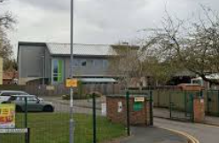
So, what do we do?
A morning routine helps children arrive at school ready to learn and play.
Think about what you need to achieve in the mornings. Can we get anything ready the the night before?
When you’ve worked out a morning routine, write it up and display it where everyone can see it.
Plenty of sleep, time and positive attention can help children cooperate with school morning routines.
Give your child positive attention for positive behaviour, rather than attention for arguing, whining or stalling. For example, say ‘I love the way you’re eating all your toast’ rather than ‘Stop playing with your toast’.
Clear routine, with changes mentioned in advance where possible.
Positive praise for the effort put into their work instead of focusing on the amount that is correct.
EBSA checklist which helps determine any barriers to school.
Open communication between parents and home.
‘Exit pass’ used at the end of the
day to encourage the child to reflect
on one positive from their school day.

Slide 5
Additional support when thinking neurodiverse
https://www.autism.org.uk/advice-and-guidance/topics/education/attendance-problems/parents

Slide 6
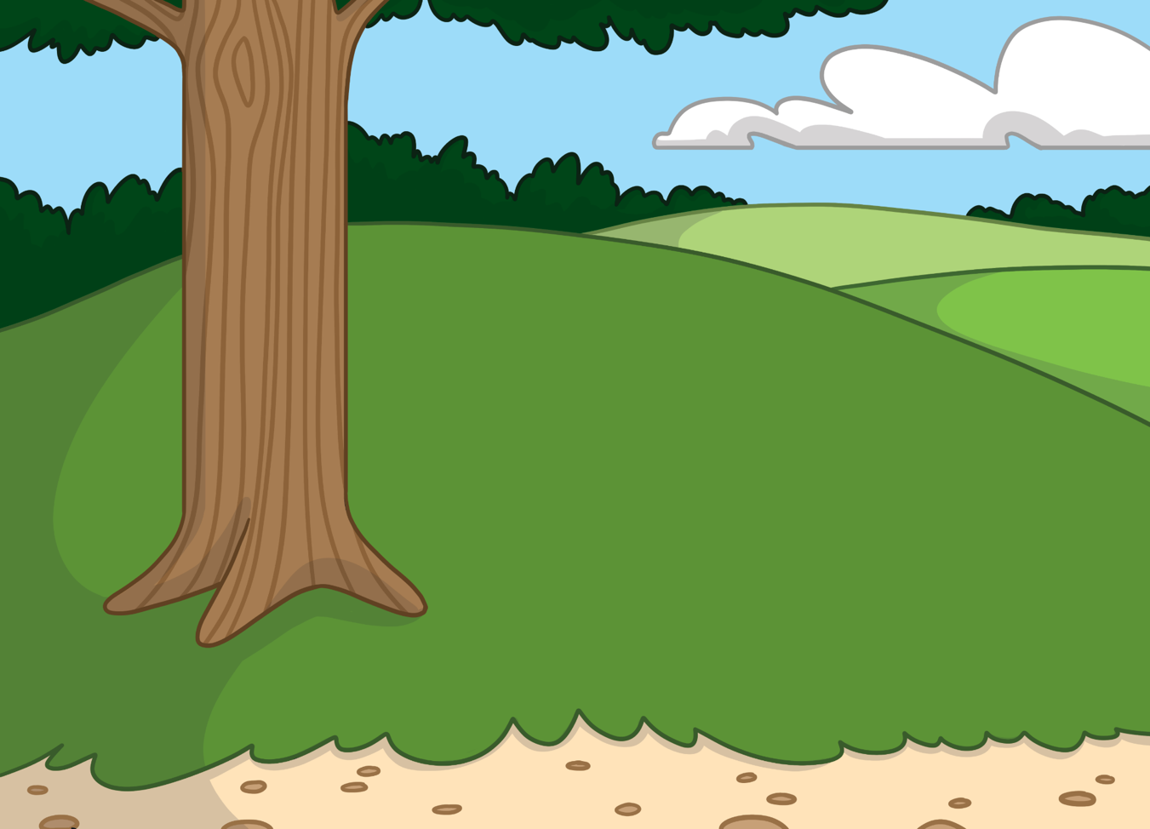
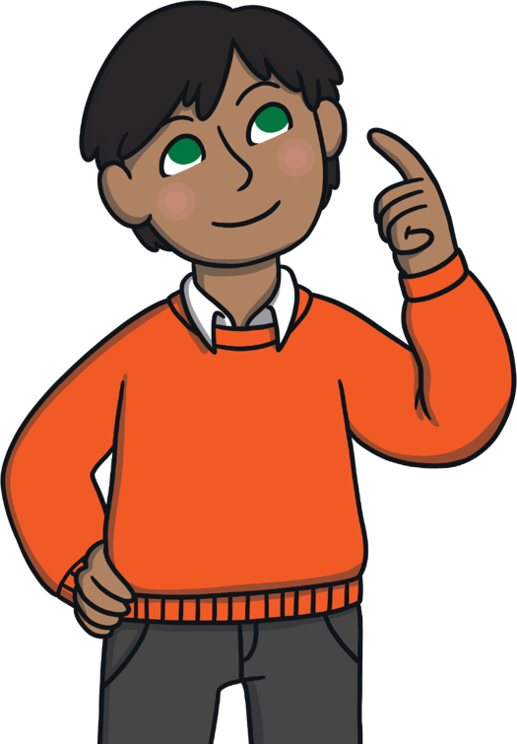
What Is a Change?
Sometimes, we choose to make a change.
Sometimes, a change happens to us and we don’t know it is going to happen.
A change is when something happens that makes you do something differently.

Slide 7
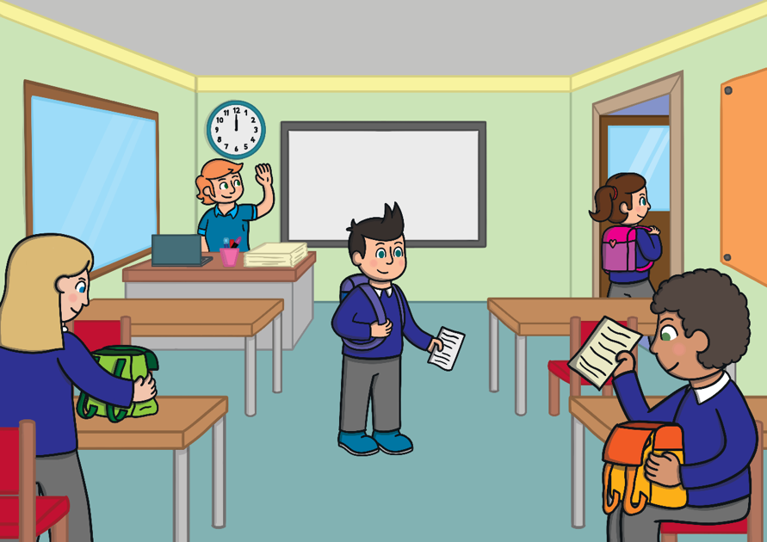
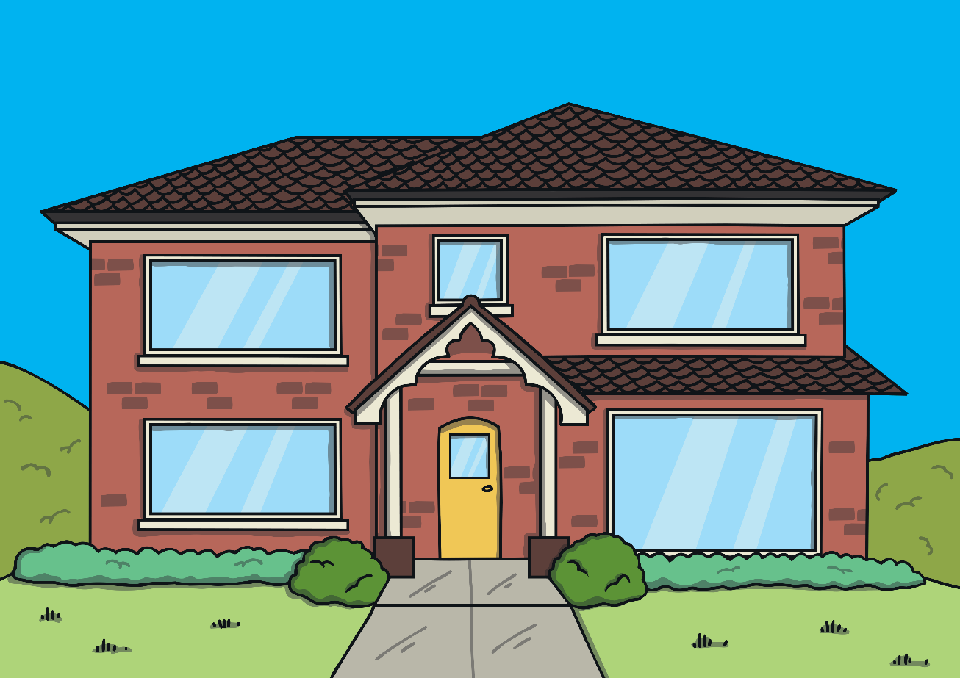
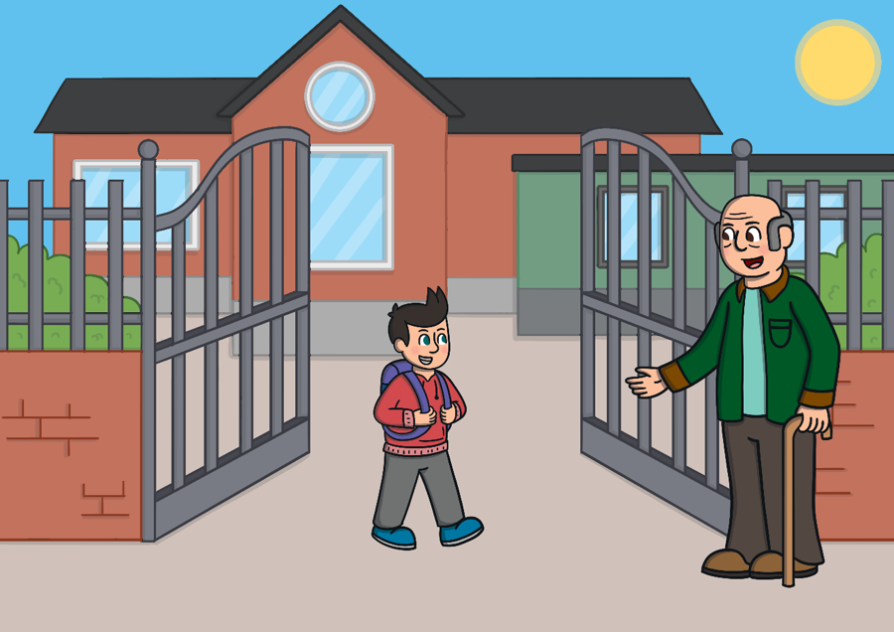
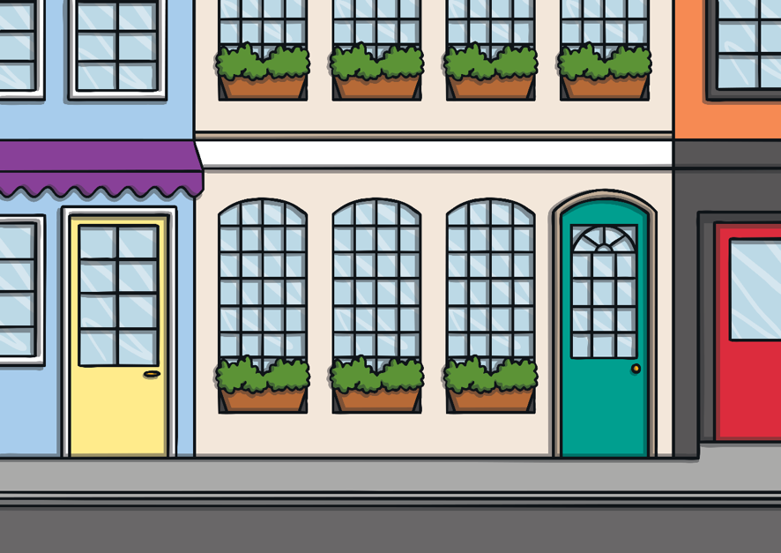
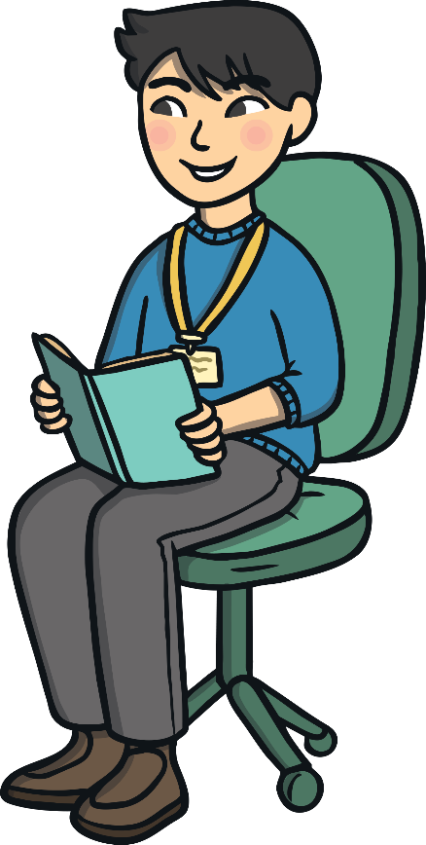
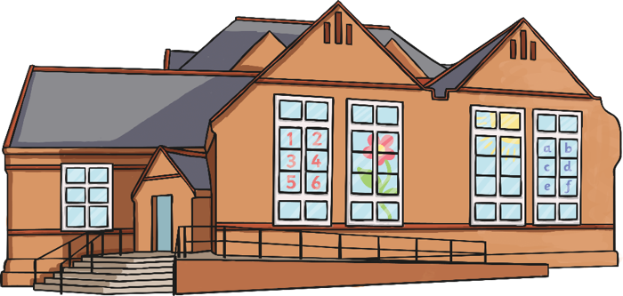

What Changes Have You Experienced?
Can you think of any changes that have happened in your child’s life so far?
Here are some examples of changes that you might have experienced:
being taught by different teachers
moving country
changing class
moving to a new school
getting a new sibling
moving town/city
starting school
moving house

Slide 8
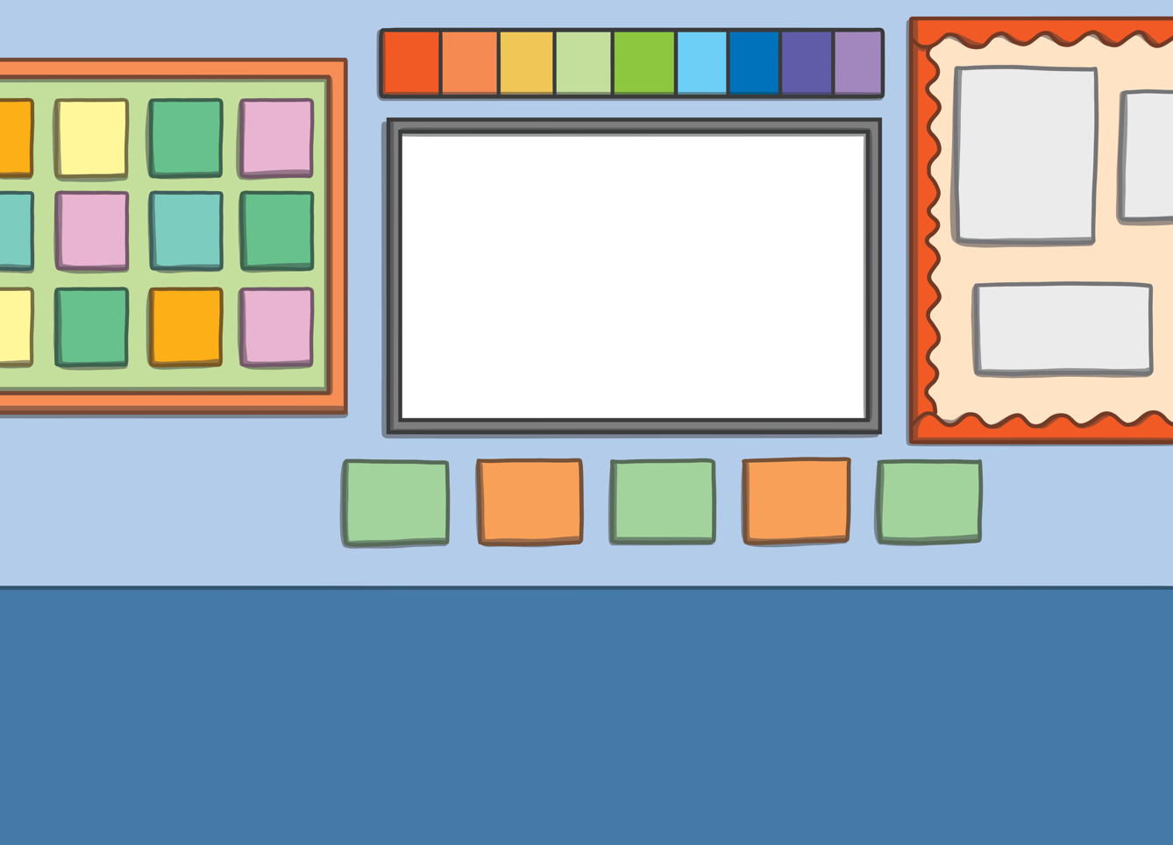


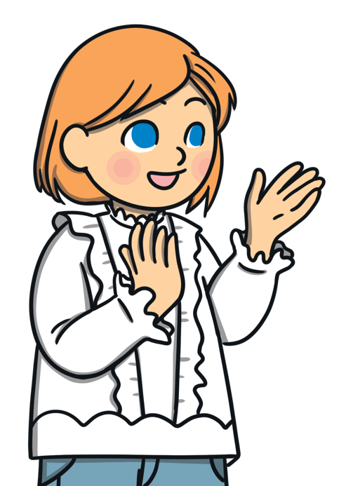

How Does Change Affect Us?
Activity
Changes can affect us in different ways.
Can you think about the last change that happened to you and make a list of the comfortable emotions you felt and then the uncomfortable emotions you felt?
Change can make us feel different emotions.
For example, you might have moved to a new house.
Some of these emotions will be comfortable and others will be uncomfortable.
You might have been excited to be moving (comfortable emotion) but nervous for the work involved(uncomfortable emotion).

Slide 9
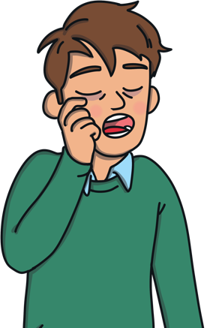
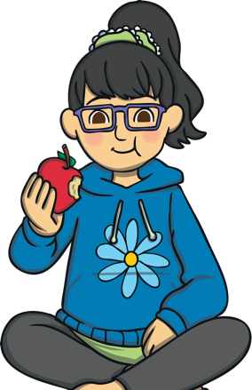
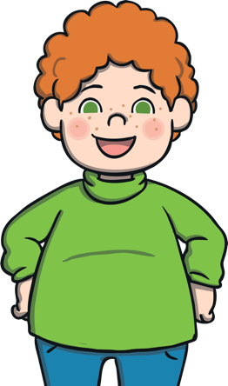
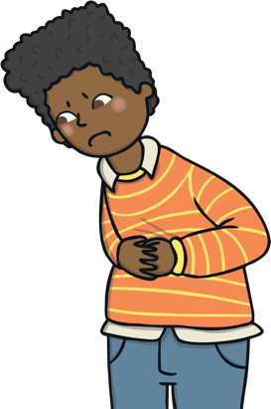
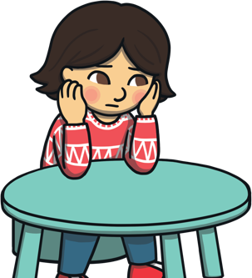
How Can Changes Make Us Feel?
Changes can make us feel different emotions but they can also affect how our bodies feel.
Sometimes changes can make us:
feel tired (we may want to sleep more than normal or less than normal)
change the way we eat (we might feel hungrier or not as hungry)
have feelings of excitement which make our breathing faster
struggle to concentrate on a task
have headaches or stomach aches

Slide 10
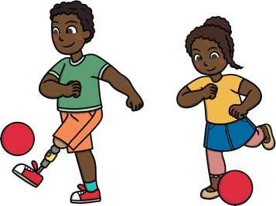


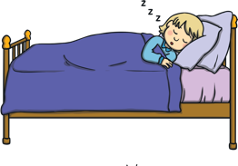


How to Look After Your Wellbeing Before a Change Happens
Get a good night’s sleep.
When we know a change is about to happen, our mood can change and our wellbeing might be affected.
Try mindfulness activities such as colouring and mindful breathing.
It is important to look after yourself and your child, encourage them to do the things that they enjoy and make them feel positive.
Get some exercise and fresh air.
Remind yourself that you are trying your best and your best is always good enough.
Have a good bedtime routine.
Continue to do the hobbies you love.

Slide 11

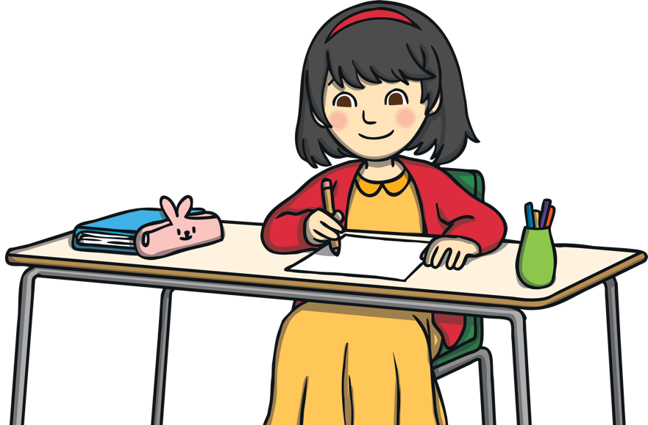
Activity – Managing the Change Moving to a New Home
Here are some of the changes that you may need to make:
Activity
Meet new friends living nearby.
Decide what you might want to give away.
Think about the small changes that you may need to make when you move to a new home. Take a few minutes to write them all down.
Think about what you want to take with you.
Find new activities that you can join.
You may need to share a room with siblings or have your own room for the first time.
Perhaps you need to move area as well to a new village, town or city.

Slide 12


Achieving Small Changes to Create A Big Change
Each small step that you achieve will bring you closer to achieving the big change, in this example, moving home.
Each of those small changes that you have written down is achievable.
If you have to make a big change, focus on one small change at a time. Once you have completed it give yourself a small reward, such as saying well done to yourself or tell an adult what you have done.
This technique can be used for any big change by taking the time to think about all the small changes that combine to create the big change.

Slide 13

Other Ideas to Help You With Changes
There are many ways you can make changes feel positive.
Here are some that you might like to try:
Ask someone who has been through the same change.
Look after yourself.
Think about what the positives could be.
Talk to an adult.
Remind yourself what you are grateful for.
Use positive words to help you feel brave about the change.
Talk to a friend.
Can you think of any ideas?
Do the things
you love.
Reward yourself for small changes.

Slide 14
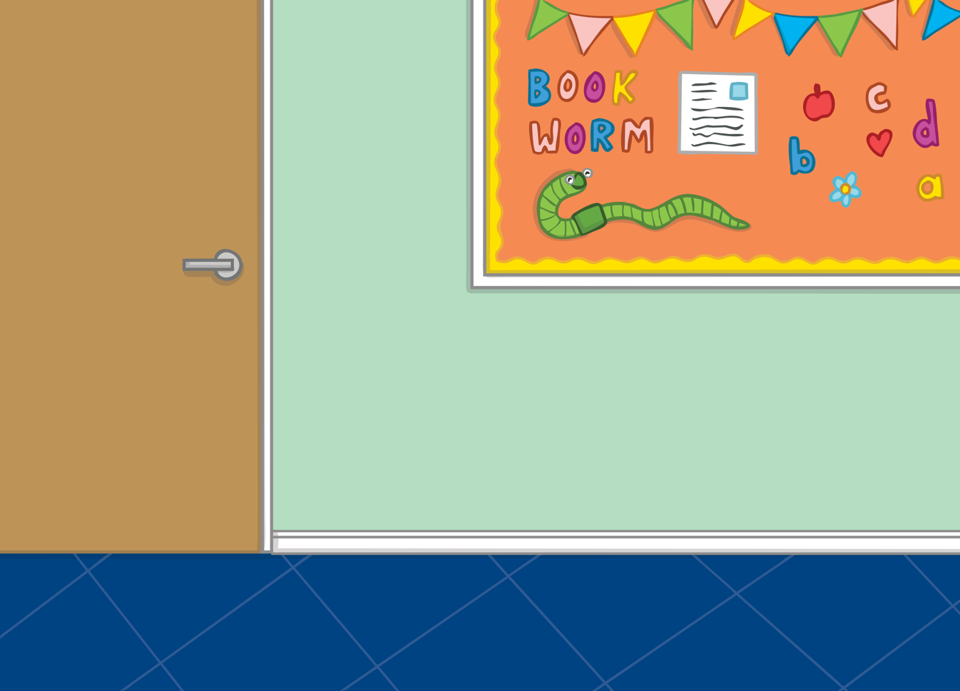
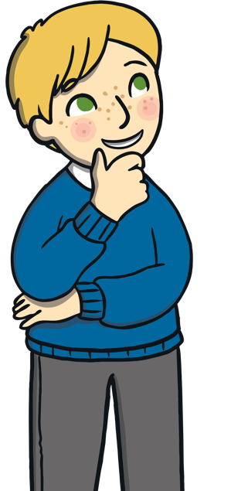
What Can You Do after the Change Has Happened?
When the change has happened, you might want to take a few minutes to think about what happened.
When you have done this, you can use what you have learnt if you need to make the change again.
What were the two most difficult things about this change?
Now is the time to relax and do something you enjoy.
What were the two best things about
this change?

Slide 15


Self-Care Ideas
You might like to try:
getting a good night’s sleep with a regular routine
taking a warm bath or shower
reading a book you love
listening to your favourite, happy music
going for a walk and look at nature, noticing what is happening around you
talk to friends and family
play sport with others.
crafting
baking
practising mindfulness
practising relaxation techniques.
writing or drawing in your journal
create a “I am grateful for…” list
There are some great ways to look after yourself during and after a change. These are just some ideas but you might have your own hobbies that you love doing. Just remember to do what you enjoy.
Self care

Slide 16
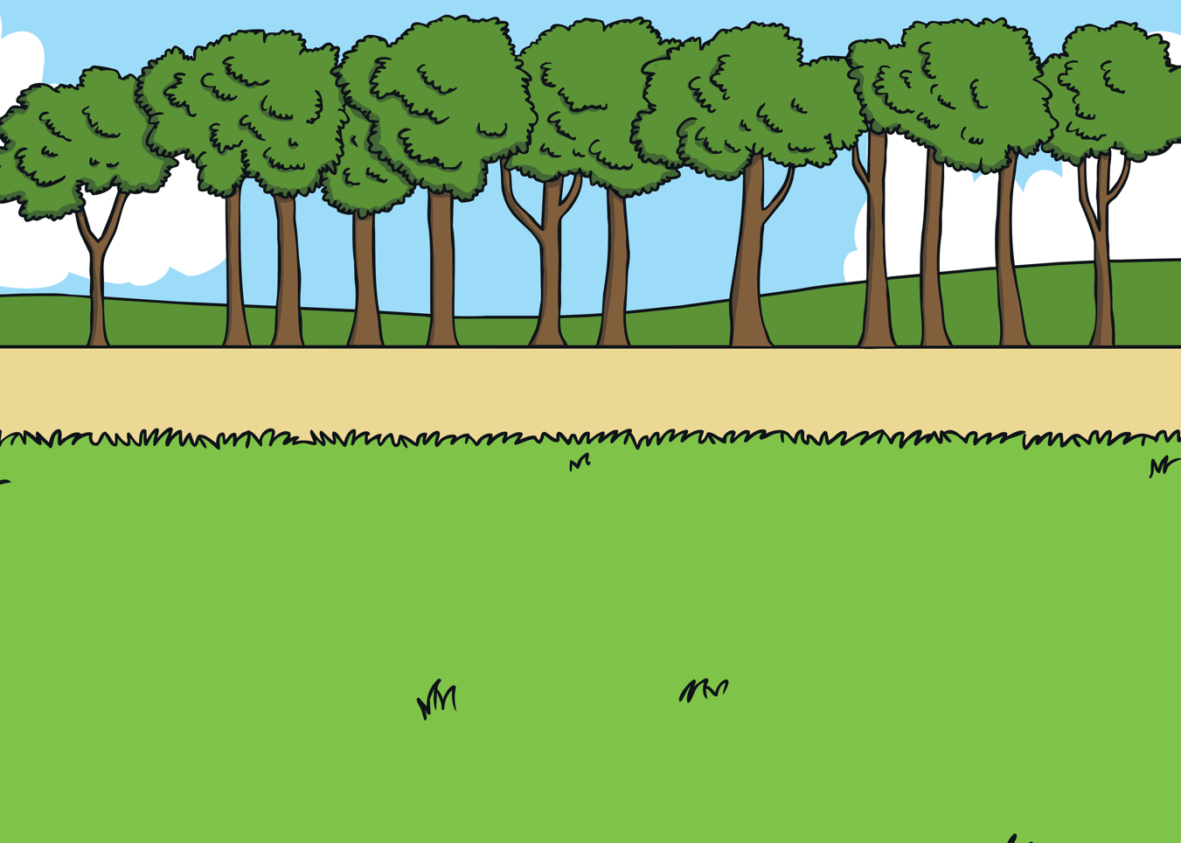
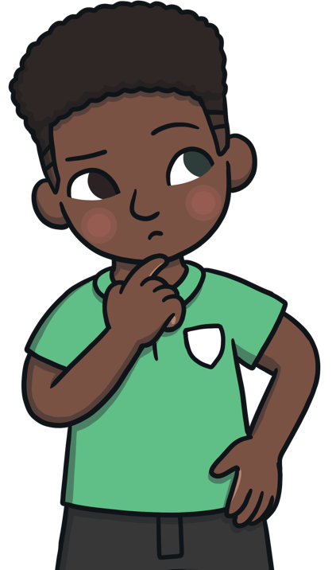
Summary
Always think and talk positively to yourself.
Look for the positives in any change.
Take some time to think about the change that has happened – find two positives and two areas to learn from.
Use self-care ideas to help you feel happy and relaxed.
Always remember to talk to an adult if you need any help.
Changes can be difficult to deal with. They can cause worry and affect your wellbeing.
Being aware of the effects change can have on you is important so you can recognise the feelings and do something you enjoy to make you feel good.
Helping your mind and body stay calm before, during and after a change is important.
Break a change down into small steps rather than leaving it as one big change.

Slide 17
Transitions at school:
Sports Day
Visitor
Have a go Heroes
Swimming lessons
School trip
Collective Worship
New classroom / year group
New adult in the classroom
Subject change
Break / Lunch time
What do we do?
Weekly timetable
Daily timetable
Transition booklets/ social story (made with the child)
Jobs to the new classroom
Pre-telling → explaining why the change is happening – what are the good things about this change

