Slide 1
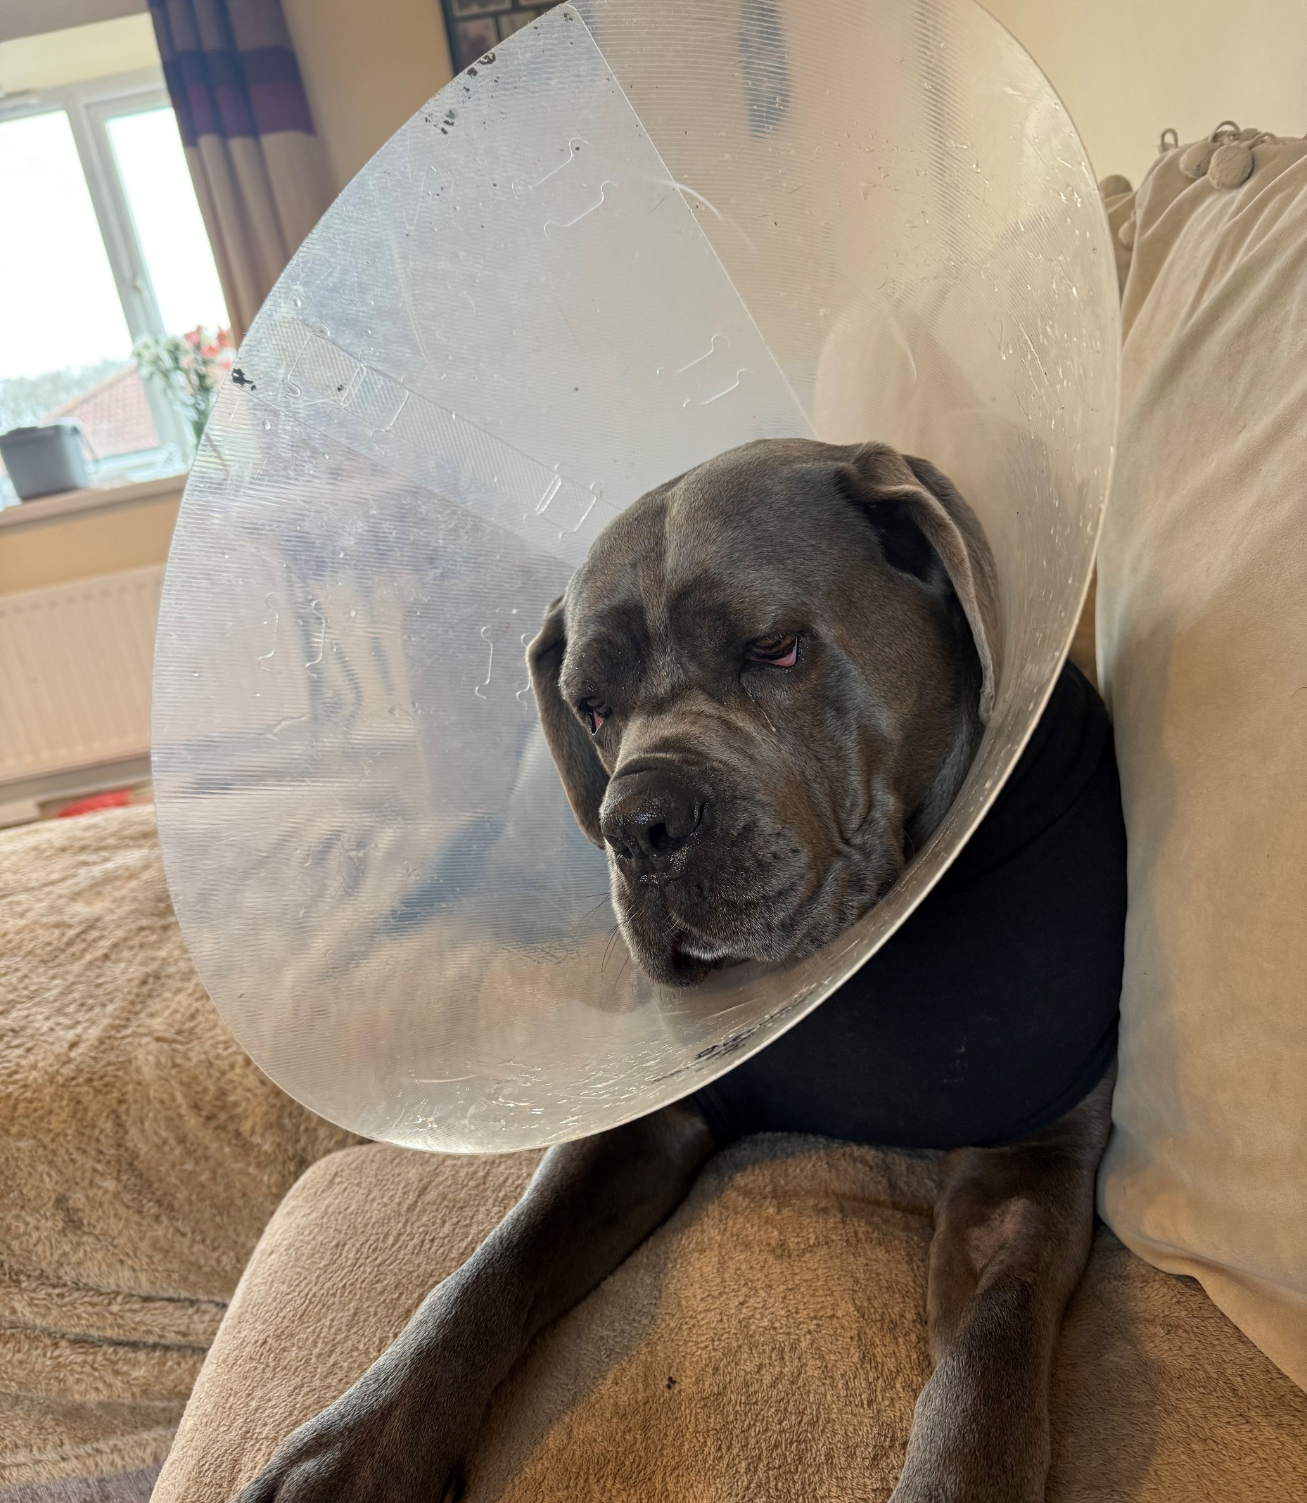
Our volunteer therapy dog has taken poorly and is having to rest for a minimum of 12 weeks.
That means that she is unable to come to school to see us until she is better.
Let’s wish Skye a speedy recovery.
Fundraiser by Marisha Porter : TPLO surgery for Skye the therapy dog

