Slide 1

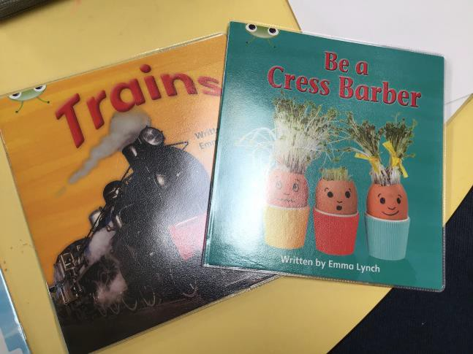
Highcliffe
St Mark Primary School
Foundation and Key Stage 1 Reading Scheme 2025

Slide 2

Phonics
Phonics is taught daily throughout Foundation stage and Key stage 1.
It is the foundation blocks to how we teach early reading and writing.
In 2022 we embedded a new phonics accredited scheme called Anima-phonics.
The programme has been designed to make phonics the highlight of every day. Anima Phonics is sprinkled with magical moments and memorable characters so that children leave school each day desperate to share their new phonic knowledge with everyone at home.

Slide 3
How is phonics taught?
Phonics is taught through 6 different phases that systematically build on a child's prior knowledge.
Phase 1 should be taught in pre-school and focuses on a child’s ability to
discriminate between different sounds and is something that is woven throughout our Foundation Stage.
Phase 2 -6 introduces the children to synthetic phonics, which is the process of synthesising (or blending) the sounds of a word together.
Research tells us that teaching children the phonic code is the quickest way to unlocking the English language and synthetic phonics is the proven method to achieve success for all children.

Slide 4
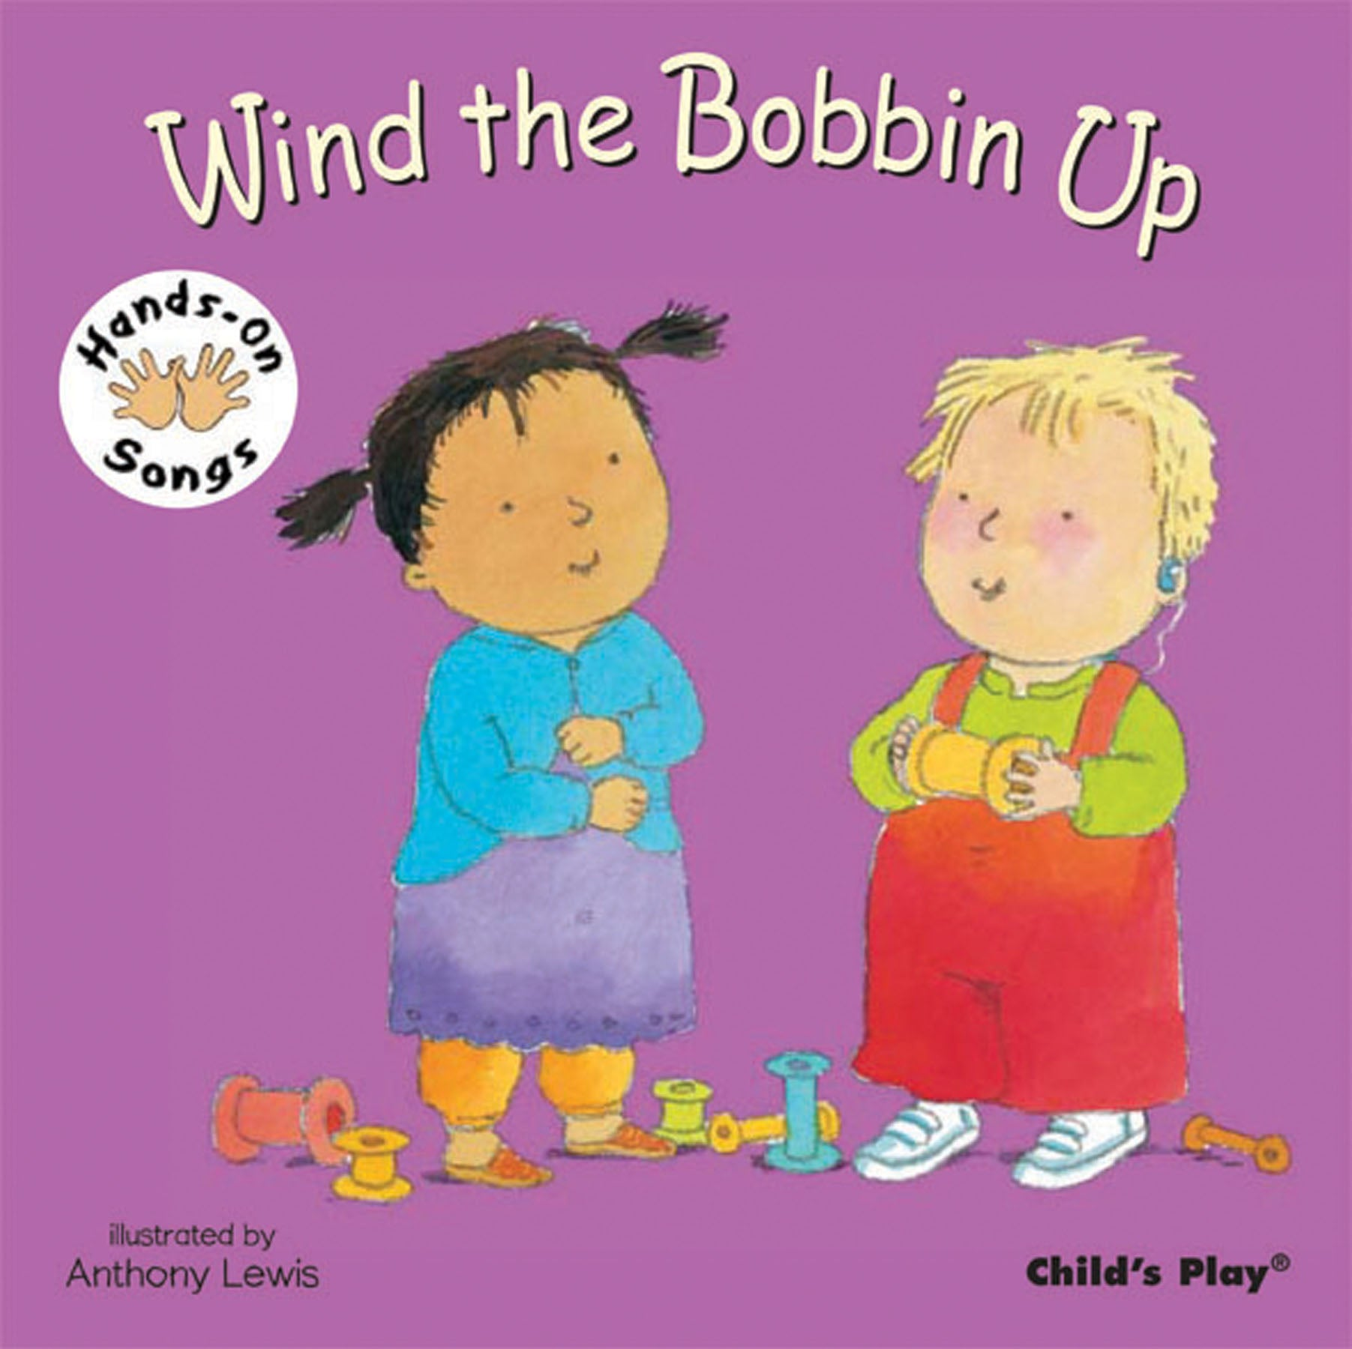
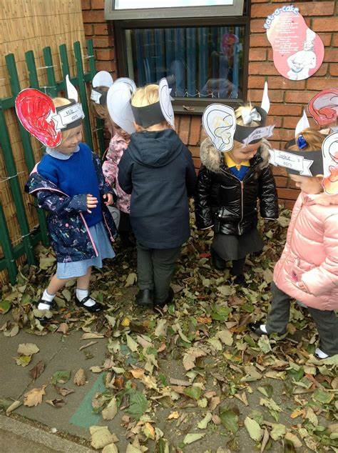
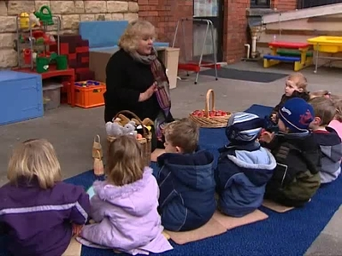
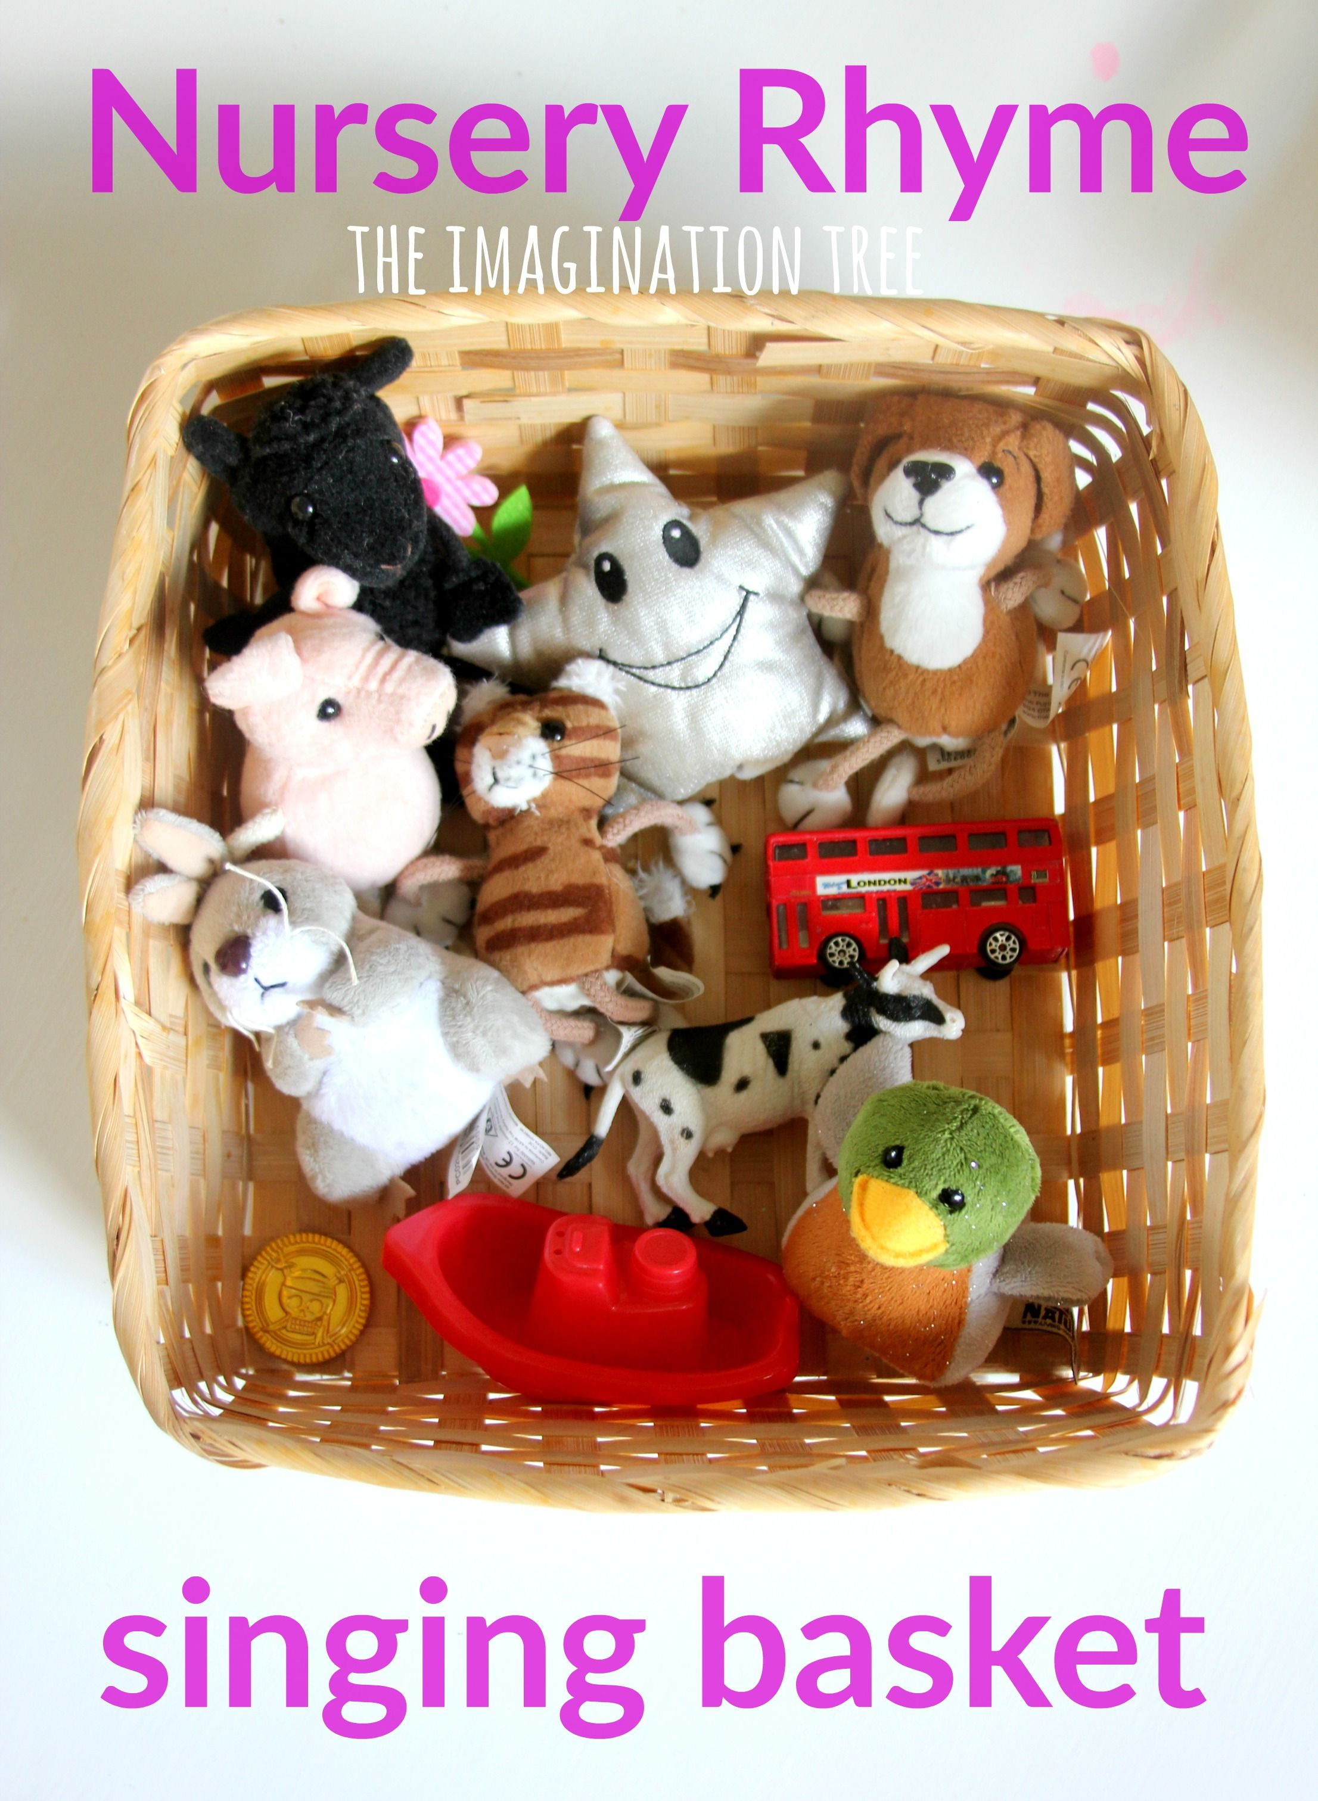
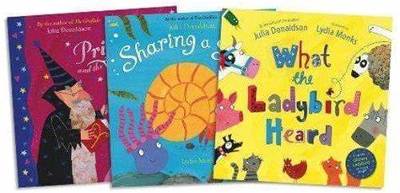
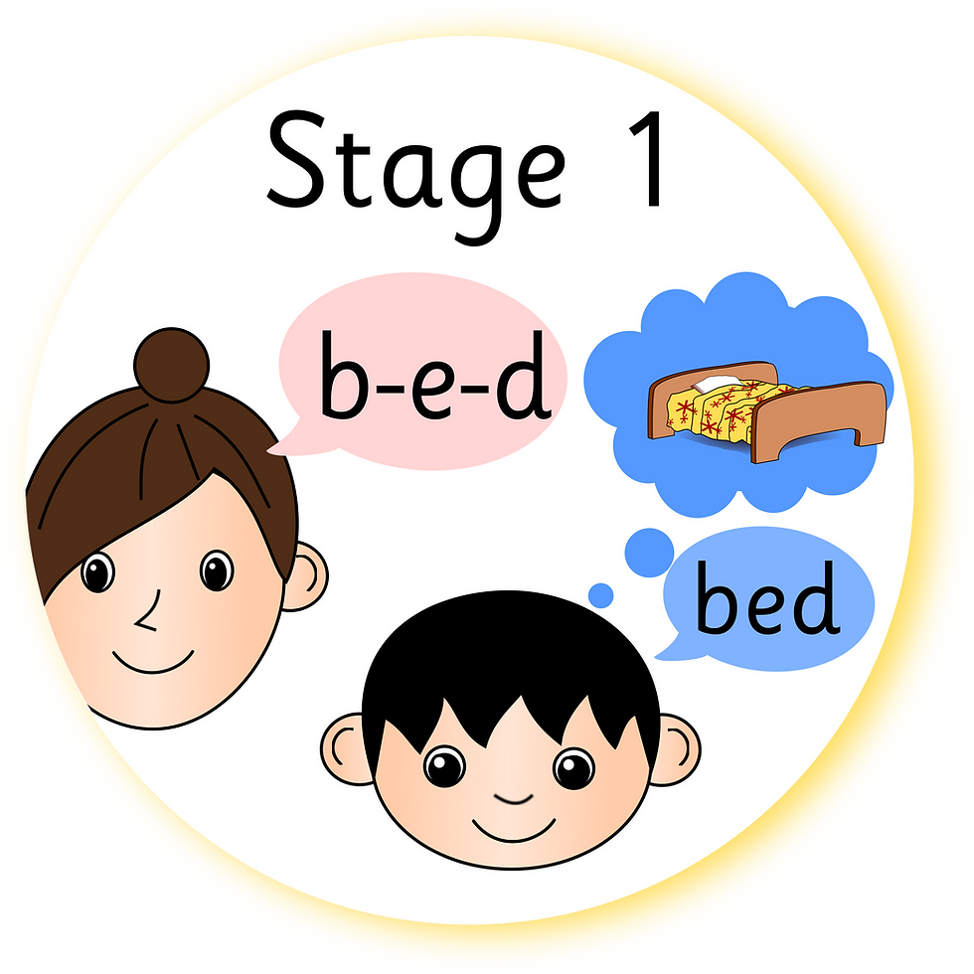
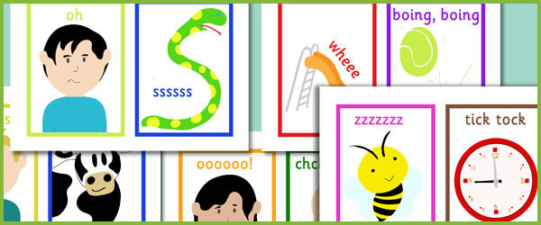
Phase 1
These activities concentrate on developing children’s speaking and listening skills, phonological awareness and oral blending and segmenting.
-Environment sound discrimination
-Instrumental sound discrimination
-Body Percussion
-Rhythm and rhyme
-Alliteration
-Voice sound aspects
-Oral blending and segmenting

Slide 5

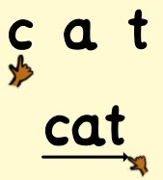

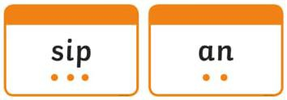

Phonics Vocabulary
Phoneme – smallest unit of sound (e.g. s, a, t, p)
Diagraph – two letters representing one unit of sound (e.g. sh, ai, ee, th)
Trigraph –three letters representing one unit of sound (e.g. air, ear, igh)
Segmenting – separating the individual sounds in a word to be able to read
or write it. We use our ‘toy talk’ arms to help us!
Blending –merging the sounds together to read a word.
Rainbow words – common exception words- words where usual spelling rules
don’t apply. We call these ‘silly sounds’.
Sound Buttons and sound lines- sausages and beans! These help the children to segment and blend the sounds within a word.

Slide 6
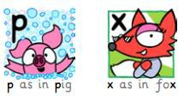
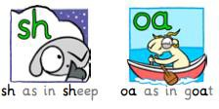
There are 26 letters in the alphabet and each letter has its own sound.
However, there are more than 26 sounds - there are 46 in fact! We use combinations of letters to make these additional sounds.
A digraph uses two letters to make one sound

Slide 7
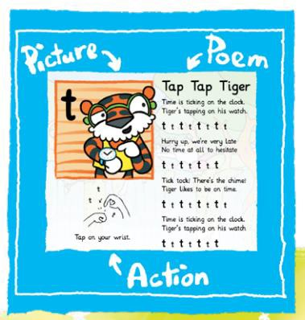
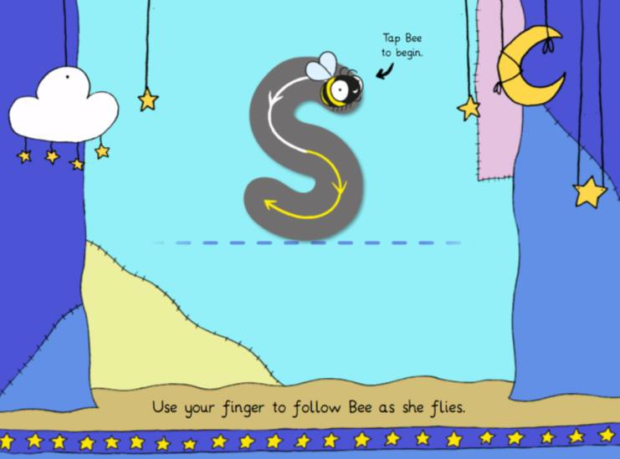
How do we teach phonics?
Anima phonics uses memorable animal characters and mnemonics.
Each sound is introduced with a picture, poem, song and action.
The actions and songs support the children in being able to recall the different sounds.
There are also fun resources
to help with letter formation.
Phase 2 - t - ANIMA PHONICS

Slide 8
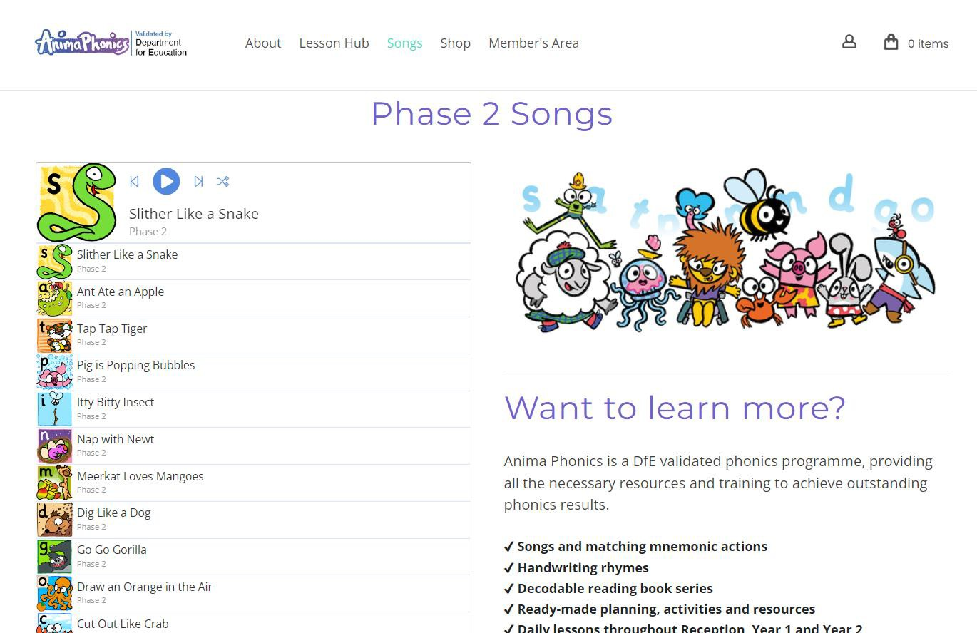
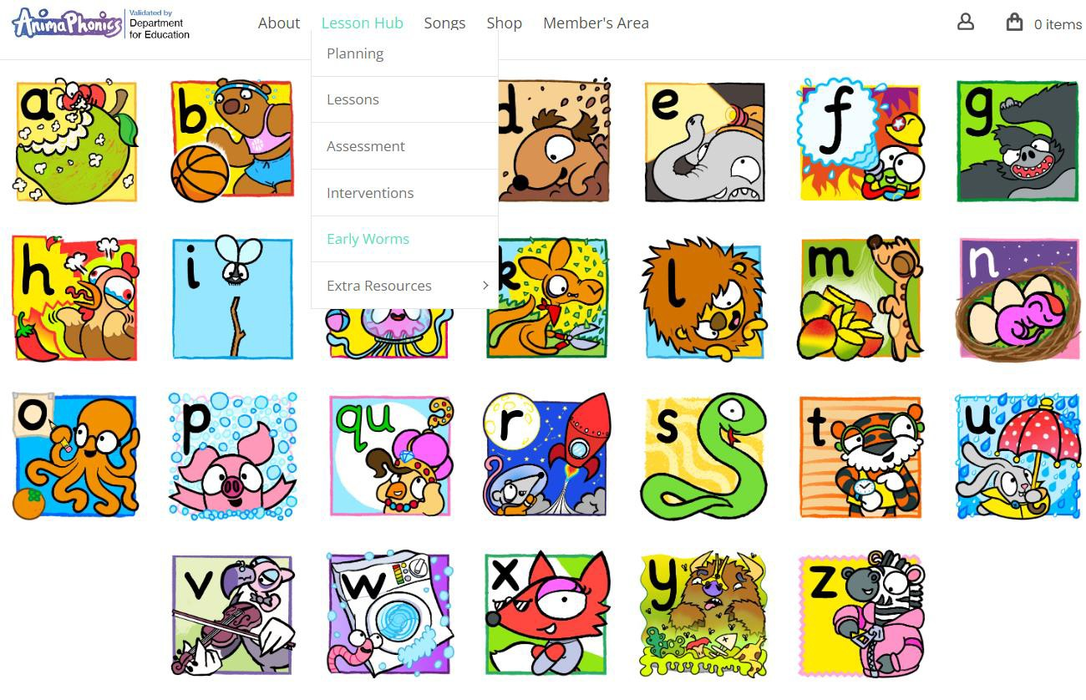
Accessing Anima material at home

Slide 9

The 100% reading accuracy model
We work with each child on a 1:1 basis each week to practise their phonics and reading. We will let you know when your child is ready to take their first reading book home.
Our reading books have been carefully matched to the sounds and words that the children know.
When a child is given a new book they will be able to read 100% of the text meaning they can enjoy reading with growing fluency and will therefore be more able to talk about what they have read to you.
Banded or colour books help your child to practise specific phonic sounds and words that they know so they embed this knowledge in their long term memory.
Your child's teacher or TA will individually select a book that they know your child will have complete success in reading.
They should not be struggling with new sounds, rather, practising ones they are familiar with.

Slide 10
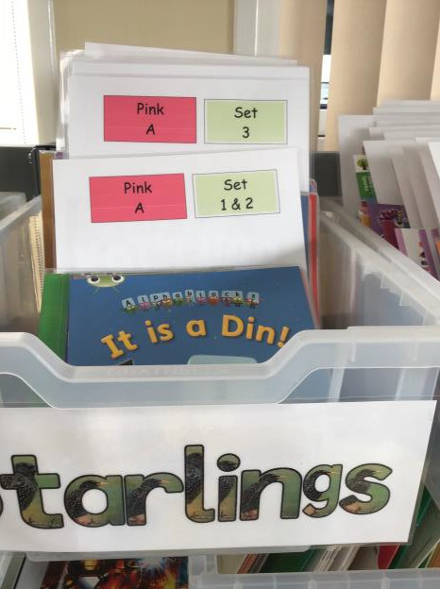
How have the books been organised?
All Book Band Books have been carefully read and levelled by
members of staff.
Although we are still using colours to help define our book bands, these are different to ones you may have already experienced at Highcliffe St Mark with older siblings. You will also notice that we now have sets within each colour band.
The books are much more carefully levelled using specific phonic sounds, rainbow words and high frequency words which match our phonics teaching sequence in school.
We have also ensured that no matter which publication the book is from, the level of difficulty is the same within each colour and set.

Slide 11
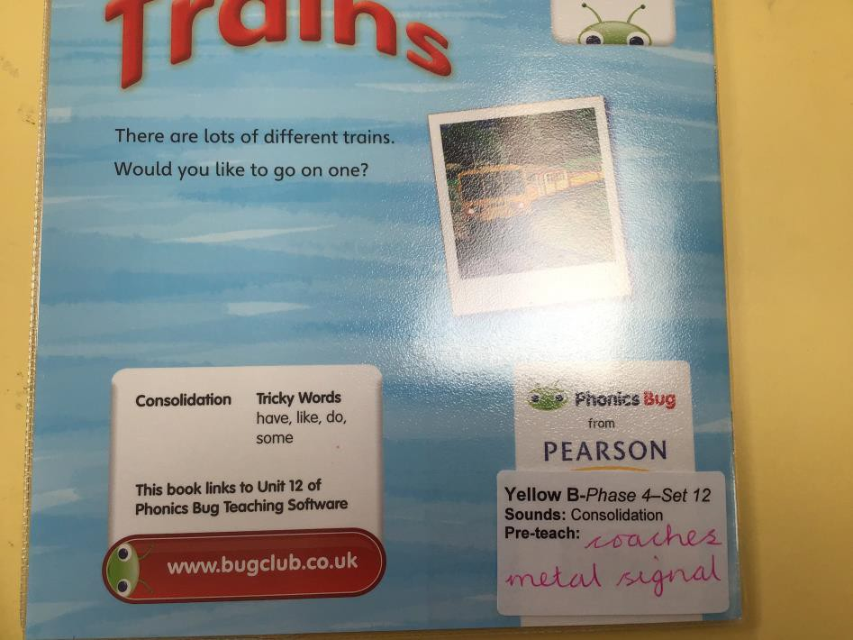
Stickers on the books
Each book has a sticker on the back detailing the sounds that are focused on in the text as well as any words that might be new to your child.
There are a maximum of 5 new words in a book which your child will need help to read and practise before they start reading their new book. Sometimes there won’t be any. You can find these words on the sticker on the back cover of the book.

Slide 12
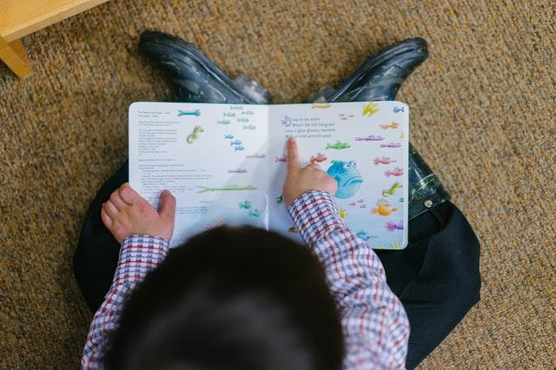
How often will my child’s book be
changed?
The class Teacher and TAs will issue a new book weekly, selecting one alongside your child. Your child will be given 1 banded book per week alongside their ‘love of reading book’.
Re-reading books that your child has complete success in builds their confidence and helps to ensure sounds they have learnt are transferred to their long term memory. By re-reading the texts in the set they will also be building their vocabulary and sight words with the pre-teach vocabulary.

Slide 13

Love of reading books
In addition to their scheme book your child will also bring home a ‘love of reading’ book.
These books are not levelled and are not part of our scheme. You can
identify them because they will have a special ‘love of reading’ sticker.
Love of reading books are books for you to share with your child. Children are NOT expected to be able to read these books. This will mean you reading it to them or with them, and helping them to understand unfamiliar words.
The books are a mixture of fiction and non-fiction, some longer and some shorter books. These books will support your child’s experiences of different reading materials and should inspire their desire to learn to read.
These books will certainly inspire a family discussion and will increase your
child’s vocabulary if you take the time to explore any new words!

Slide 14
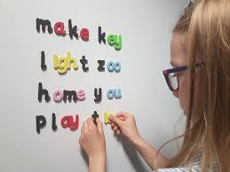
What else can I do to help my child with reading?
Being able to read their book successfully will enable your child to talk about what they have read. It is really important to take some time to ask questions during and at the end of reading a book to your child or when they have read to you.
Children won’t be able to take a book from the next level until they securely know the phonics and words they will come across in the next book so helping your child to learn new phonics and words through playing games will help them to move through our new scheme.
Value the re-read. We can’t stress how important this is for fluency, confidence and enjoyment.
In Foundation you can also watch the teacher led videos on the website to follow the classes progress through the scheme.
Home | Highcliffe St Mark Primary School (highcliffeprimary.dorset.sch.uk)

Slide 15
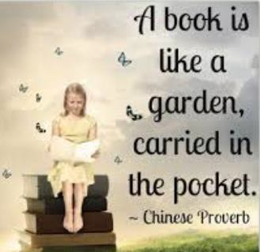





Slide 16
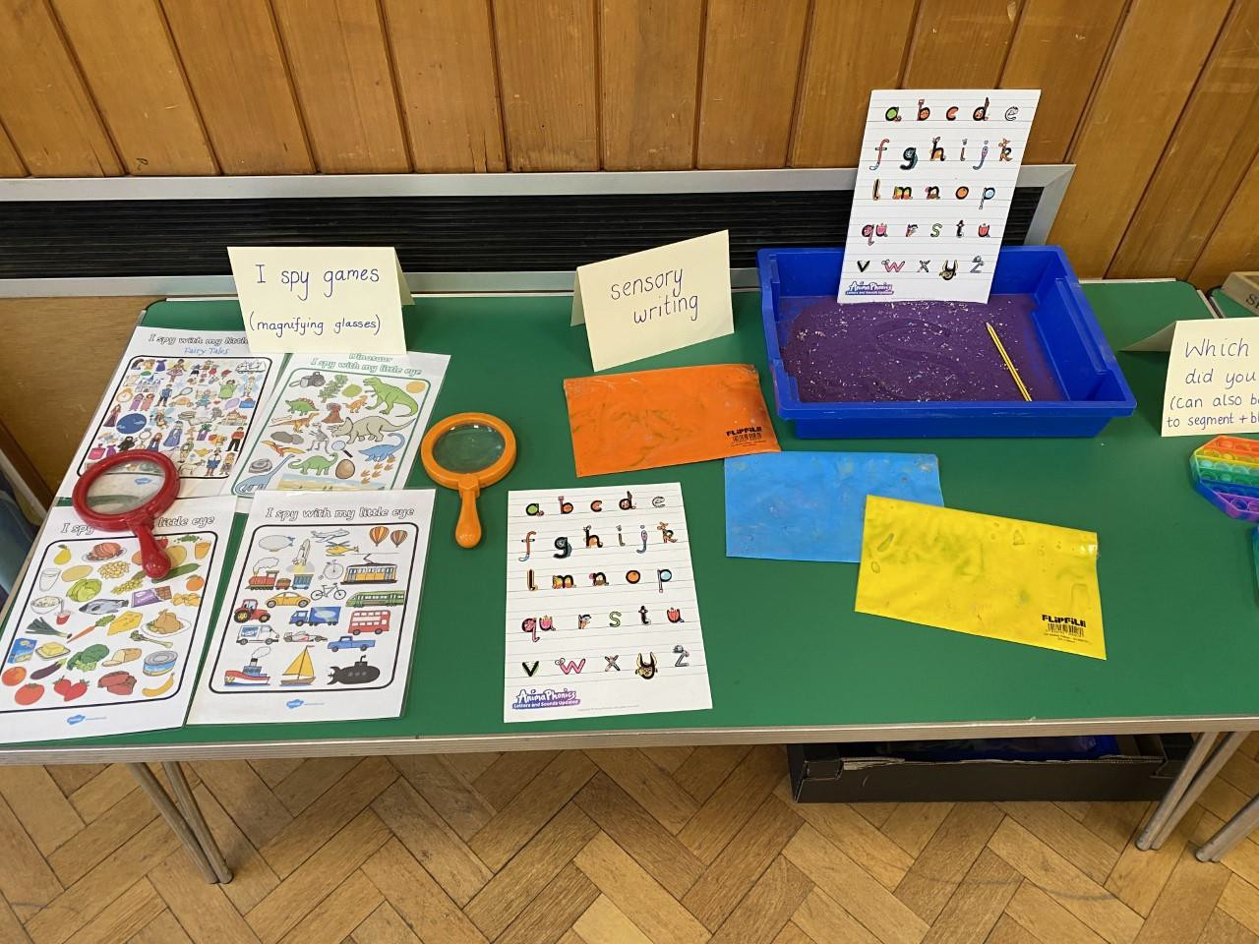
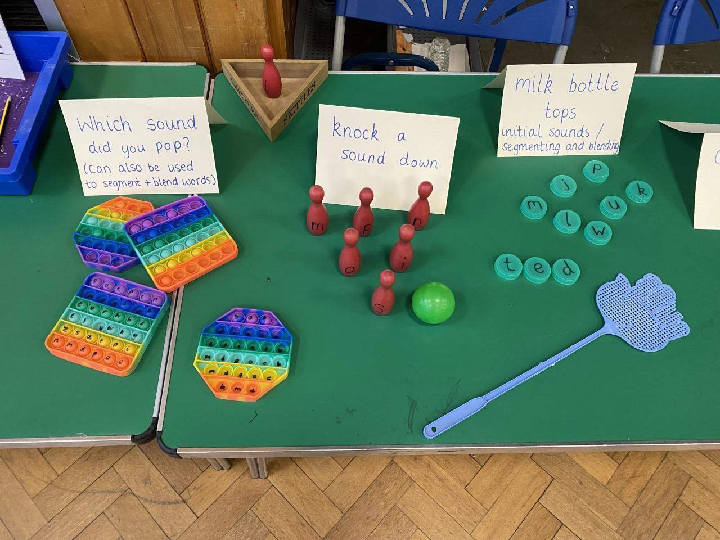
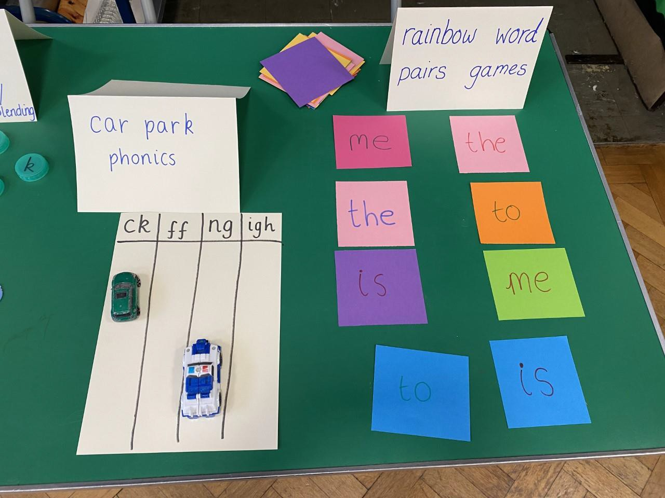
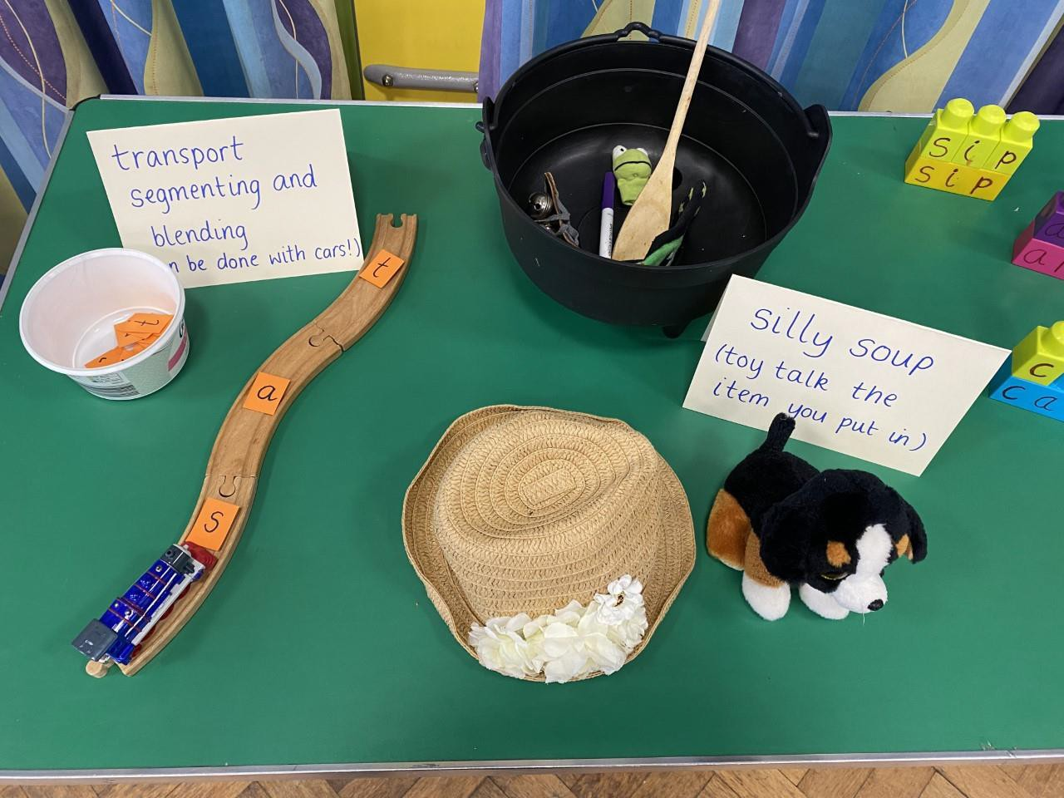

Slide 17
